Slide 1
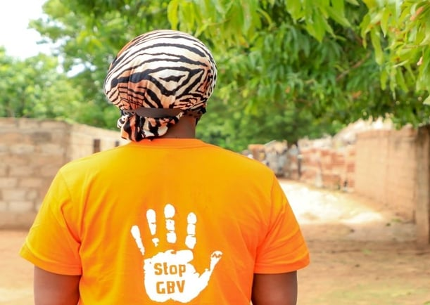
Gender-Based Violence and introduction to Human Rights Principles Training
12th-13th April 2024

Slide 2
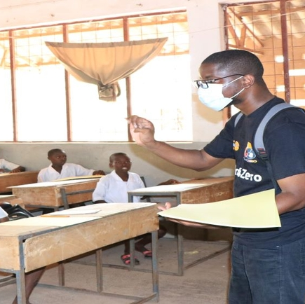
1. Introduction and training overview
Notes:
Introduction of facilitators
Introduction of participants
Presentation of the detailled Agenda – next slide
Questions to participants: what are your expectations?
Rules during the training:
raise hands to ask a question
Listen to each other
Be on time
Pay attention – the slides and additional material will be given to you after the training

Slide 3
Detailed Agenda
Day 1 – 12 April 2024 | Day 2 - 13th April 2024
1. Introduction and training overview Audience and facilitators introduction Ground rules and expectations Sessions overview | Recap Day 1 Answer Questions Participant recap
2. Understanding Gender-Based Violence (GBV) Definition Prevalence and types of GBV Causes, contributing factors and consequences of GBV | 5. Reporting mechanisms and support for survivors Presentation of reporting mechanisms Services and support available for survivors: psychosocial, medical, legal
3. What are Human Rights? Definition Quizz | 6. Case study – Reporting as a survivor
4. Legal Frameworks protecting against GBV and ensuring Human Rights - International Laws - National Laws and policies | 7. Conclusion training and Q&A

Slide 4
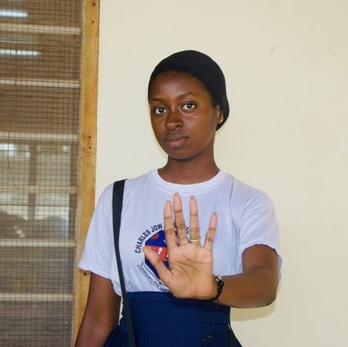
2.Understanding Gender-Based Violence (GBV)
By Dr Armanda NANGMO,
GBV Shelter/GMIS Centre Manager

Slide 5
Agenda
1
2
3
4
5
Key definitions
Prevalence and Types of GBV
Risks and Causes of GBV
Consequences of GBV
Summary

Slide 6
Definitions
Sex
Gender
Power
Gender-Based Violence

Slide 7
Definitions: Sex vs. gender
Sex
Gender
Refers to the biological and physical characteristics that define men and women. This includes reproductive systems (women have breasts and internal reproductive organs capable of gestating children, men have external reproductive organs, etc.).
Refers to the social differences between males and females that are learned. Though deeply rooted in every culture, social differences are changeable over time, and have wide variations both within and between cultures. “Gender” determines the roles, responsibilities, opportunities, privileges, expectations, and limitations for males and for females in any culture.
Notes:
Now let’s look at the definitions of sex and gender.
Sex: Refers to the biological and physical characteristics that define men and women. This includes reproductive systems (women have breasts and internal reproductive organs capable of gestating children, men have external reproductive organs, etc.).
Gender: Refers to the social differences between males and females that are learned. Though deeply rooted in every culture, social differences are changeable over time, and have wide variations both within and between cultures. “Gender” determines the roles, responsibilities, opportunities, privileges, expectations, and limitations for males and for females in any culture.
- IASC Guidelines for Integrating GBV Interventions in Humanitarian Action

Slide 8
Definition: Power
Types of power
Power is the ability to influence or to control, people, resources and/or events.
Power Over
Power Within
Power With
Power To

Slide 9
Power over means the power that one person or group uses to control another person or group; it also means being able to impose decisions on others and is tightly connected to status
Notes:
In order to understand GBV it’s important to also understand different types of power and how they can be used. Power over means the power that one person or group uses to control another person or group; it also means being able to impose decisions on others and is tightly connected to status.
*Ask for an example. If none are provided, the following (or others from your context) can be used*:
Parents imposing decisions on their children
Police arresting a criminal
A man deciding how his wife’s income will be spent

Slide 10
Power within is the strength that arises from inside ourselves when we recognize the equal ability within all of us to positively influence our own lives and the community
Notes:
Power within is the strength that arises from inside ourselves when we recognize the equal ability within all of us to positively influence our own lives and the community
*Ask for an example. If none are provided, the following (or others from your context) can be used*:
The power to choose emotions and reactions
The power to choose what I think and feel

Slide 11
Power with means the power felt when two or more people come together to do something that they could not do alone; it also includes joining our power with individuals as well as groups to respond to injustice
Notes:
Power with means the power felt when two or more people come together to do something that they could not do alone; it also includes joining our power with individuals as well as groups to respond to injustice
*Ask for an example. If none are provided, the following (or others from your context) can be used*:
A women’s collective joining together to make products they cannot make alone
A group of people coming together to protest a community leader’s decision

Slide 12
Power to is the belief and actions that individuals and groups use to create positive change; it is also when individuals proactively work to ensure that all community members enjoy the full spectrum of human rights and are able to achieve their full potential
Everyone has power to even if they were not able to express it internally.
Notes:
Power to is the belief and actions that individuals and groups use to create positive change; it is also when individuals proactively work to ensure that all community members enjoy the full spectrum of human rights and are able to achieve their full potential.
Everyone has power to even if they are not able to express it externally.
*Ask for an example. If none are provided, the following (or others from your context) can be used*:
Your ability to act, even if it is limited. For example, you can choose what time to go to bed tonight.
You can choose what clothes to wear
You can choose to act in positive or negative ways towards others
*Ask the participants what kinds of power they think they have.*

Slide 13
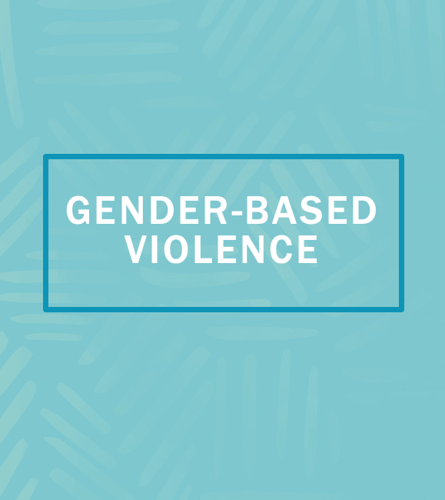
Gender-based violence is an umbrella term for any harmful act that is perpetrated against a person’s will, and that is based on socially ascribed (gender) differences between males and females.
It includes acts that inflict physical, sexual or mental harm or suffering, threats of such acts, coercion, and other deprivations of liberty. These acts can occur in public or in private.
Notes:
Now that we have understood gender, we’re going to talk about gender-based violence. Many of you already know this term and what it means. Please turn to the person next to you and take 5 minutes to try to come up with a basic definition of gender-based violence.
*After 5 minutes, ask pairs to give you one key term each from their definition. Write them on a flip chart as you go.*
Are there any key terms that you think are missing from this definition? *Click to animate. Show IASC Guidelines definition and discuss. * Can you give me some examples of gender-based violence?

Slide 14
Gender norms: Commonly accepted social or cultural rules that specify male and female behaviours, capacities, expectations, opportunities, roles
Some examples:
Girls are valued as wives not as individuals
Women should be
Men are tough and powerful, not helpless and childish like women
Men are the family breadwinners.
Notes:
Social norms are collectively agreed-upon standards and rules that most members of a group or society adhere to and accept. Gender norms are commonly accepted social or cultural rules that specify male and female characteristics, roles, acceptable behaviors, and capacities.
These gender norms are rigid and negative for all women and girls and prevent them from reaching their full potential in life and from enjoying their human rights.

Slide 15
Prevalence of GBV
1 in every 3 women worldwide will be physically, sexually, or otherwise abused at least once in her lifetime. That’s an estimated 736 million women and girls age 15 and older who will be subjected to intimate partner violence, non-partner sexual violence, or both at least once.
.
According to the Gambia Demographic and Health Survey, 49% of 15-49 years women respondents experienced physical violence at least once since they were 15 years old and 11% said they experienced physical violence 12 months before the survey
According to the GMIS 2023 data, 60% of the 511 cases reported via the One Stop Centres were cases of sexual violence while 29 % were cases of physical violence

Slide 16
Causes of GBV

Slide 18
Risks of GBV

Slide 19
Consequences of GBV
Severe, varied and long-lasting
Impact across the family and community, but fall most heavily on the survivor

Slide 20
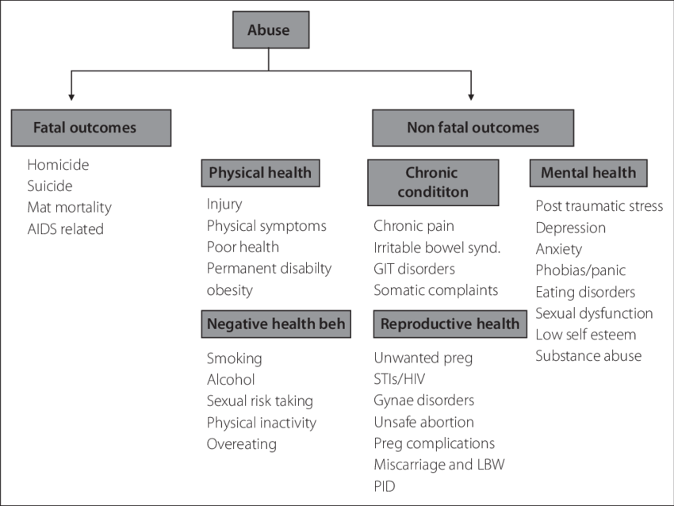

Slide 21
Summary
GBV is happening everywhere
GBV is never the survivor’s fault
GBV has tremendous negative consequences on the lives of the survivor, their family and the community.

Slide 22
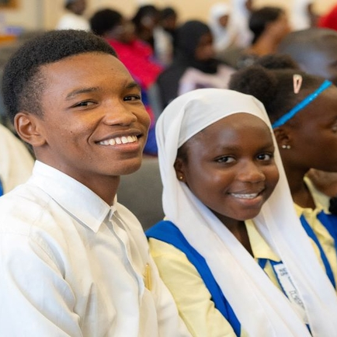
3. What are Human rights?
Alexia Lachavanne
Gender and GBV Analyst UNFPA

Slide 23
Human rights are inherent to us all – regardless of nationality, sex, ethnic origin, color, religion, language or any other status.
Basic rights and freedom to which all humans are entitled to have, to do or to receive from others.
Enforceable by law
Derived from the essential dignity and nature of humankind.
Human rights principles:
Universality
We are all, equally, entitled to our human rights.
Inalienable
Human rights should not be taken away, except in specific situations and according to due process.
Indivisible and interdependant
One set of rights cannot be enjoyed fully without the other.
Equal and non-discriminatory
All human beings are born free and equal in dignity and rights.
They are both Rights and Obligations for States and Individuals
Notes:
Human rights are inherent to us all, regardless of nationality, sex, national or ethnic origin, color, religion, language, or any other status.
Basic rights and freedom to which all humans are entitled to have, to do or to receive from others.
Enforceable by law
Derived from the essential dignity and nature of humankind.
They range from the most fundamental - the right to life - to those that make life worth living, such as the rights to food, education, work, health, and liberty.
There are some important Human rights principles:
The principle of universality of human rights is the cornerstone of international human rights law.
This means that we are all equally entitled to our human rights.
This principle, as first emphasized in the UDHR, is repeated in many international human rights conventions, declarations, and resolutions.
Human rights are inalienable.
They should not be taken away, except in specific situations and according to due process.
For example, the right to liberty may be restricted if a person is found guilty of a crime by a court of law.
But the right to life, the right to be free from torture, the right to religion etc. cannot be taken away
Indivisible and interdependent
This means that one set of rights cannot be enjoyed fully without the other.
For example, making progress in civil and political rights makes it easier to exercise economic, social and cultural rights.
Similarly, violating economic, social and cultural rights can negatively affect many other rights.
Equal and non-discriminatory
Non-discrimination cuts across all international human rights law.
This principle is present in all major human rights treaties.
They are Both rights and obligations
All States have ratified at least 1 of the 9 core human rights treaties, as well as 1 of the 9 optional protocols.
80 per cent of States have ratified 4 or more.
This means that States have obligations and duties under international law to respect, protect and fulfill human rights.
The obligation to respect means that States must refrain from interfering with or curtailing the enjoyment of human rights.
The obligation to protect requires States to protect individuals and groups against human rights abuses.
The obligation to fulfill means that States must take positive action to facilitate the enjoyment of basic human rights.
Meanwhile, as individuals, while we are entitled to our human rights – but, we should also respect and stand up for the human rights of others.

Slide 24
Civic Space & Democracy
The Right to vote and take part in government
The Right to physical and mental health
Development & Living in dignity
The Right to adequate housing
Freedom of association, expression, assembly and movement
Equality & Non-Discrimination
The Right to Education
Notes:
Participants will be asked to link each right with the right category

Slide 25
What is a Human Right violation?
Human rights violations​ committed by the State or its agents can be:​
An Act
Such as torture, genocide, arbitrary arrest
An Omission
such as where a Government fails to protect a group of people (e.g. women or ethnic groups) against systematic abuse by another
When States are violating human rights either directly or indirectly, civil society should hold them accountable and speak out.
The international community also has an obligation to monitor governments and their track records with human rights.
Notes:
Human rights violations​ committed directly or indirectly by the State or its agents (police, judges, prosecutors, government officials) can be:​
An act – such as torture, police brutality, Genocide, arbitrary arrest. ​
An omission - such as where a Government fails to protect a group of people (e.g. women or ethnic groups) against systematic abuse by another – if the state does not do anything to protect the vulnerable group, it is participating in the violations.
Accountability: States and other duty bearers to be answerable for the observance of human rights​
When States are violating human rights either directly or indirectly, civil society should hold them accountable and speak out.
The international community also has an obligation to monitor governments and their track records with human rights.
State institutions should:​
Be provided with sufficient resources, responsibilities and independent authority to effectively monitor the Government​
Eg. Independent human rights parliamentary bodies, National Human Rights Institutions, judges, courts and legal counsel

Slide 26
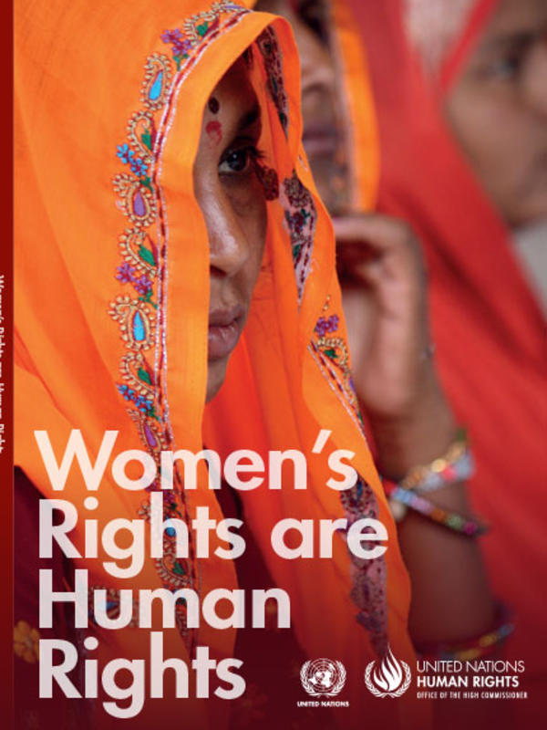
Synergies between Gender Equality and Human Rights
Unequal opportunities for the enjoyment of human rights
GENDER
IN EQUALITY
Precondition for the full realization of women’s rights and thus the fulfillment of all human rights
Notes:
When we have GENDER INEQUALITY = Unequal opportunities for the enjoyment of human rights
When we have GENDER EQUALITY = Precondition for the full realization of women’s rights and thus the fulfillment of all human rights
‘Women’s rights are human rights’ was the slogan at the Fourth World Conference on Women in Beijing in 1995
Inspired by the Vienna Declaration on Women’s Rights in 1993 that declared the indivisibility of women’s rights and human rights

Slide 27
4. Legal Frameworks protecting against GBV and ensuring Human Rights
Notes:
DISCUSS THE PHOTO
Who is in the photo?
Eleanor Roosevelt, former first lady of the USA.
What document is she holding?
She is holding the Universal Declaration of Human rights.
Why her role and the one of other women was important in drafting this document?
She was appointed, in 1946 as a Chairperson of the drafting committee of the Universal Declaration of Human Rights and played an instrumental role in drafting the Universal Declaration of Human Rights.
But other women also played essential parts in shaping the document.
The Sub-Commission on the Status of Women of the Commission on Human Rights made substantial contributions to the inclusion of women’s rights in the Universal Declaration.
Hansa Mehta of India
Only other female delegate to the United Nations Commission on Human Rights in 1947-48, was a staunch fighter for women’s rights in India and abroad.
She is widely credited with changing the phrase "All men are born free and equal" to "All human beings are born free and equal" in Article 1 of the Universal Declaration of Human Rights.
Minerva Bernardino, diplomat and feminist leader from the Dominican Republic.
She was instrumental in arguing for inclusion of "the equality of men and women" in the preamble of the Universal Declaration of Human Rights.
She had also played a crucial role in advocating for the inclusion of women’s rights and nondiscrimination based on sex in the United Nations Charter, which in 1945 became the first international agreement to recognize the equal rights of men and women.

Slide 28
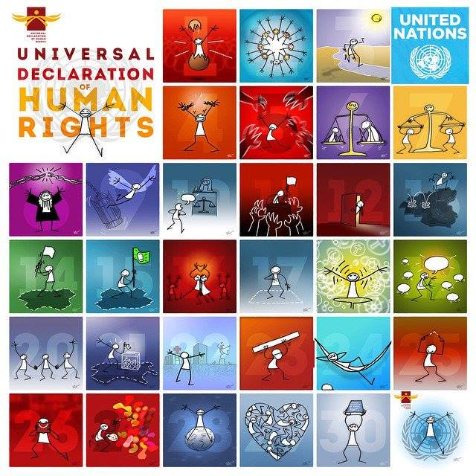
It all started with the Universal Declaration of Human rights (UDHR)
The Universal Declaration of Human Rights (UDHR) was adopted by the UN General Assembly in 1948
It was the first legal document to set out the fundamental human rights to be universally protected.
The UDHR, turned 75 years old on 10 December 2023, continues to be the foundation of all international human rights law.
Its 30 articles provide the principles and building blocks of current and future human rights conventions, treaties and other legal instruments.
The UDHR, together with the 2 covenants - the International Covenant for Civil and Political Rights, and the International Covenant for Economic, Social and Cultural Rights - make up the International Bill of Rights.
Notes:
The Universal Declaration of Human Rights (UDHR), adopted by the UN General Assembly in 1948, was the first legal document to set out the fundamental human rights to be universally protected.
The UDHR, which turns 75 on 10 December 2023, continues to be the foundation of all international human rights law.
Its 30 articles provide the principles and building blocks of current and future human rights conventions, treaties and other legal instruments.
The UDHR, together with the 2 covenants - the International Covenant for Civil and Political Rights, and the International Covenant for Economic, Social and Cultural Rights - make up the International Bill of Rights.

Slide 29
Where are Human Rights written down?
International Laws
Regional Legal frameworks
National legal
frameworks
Binding:
Treaties Conventions Covenants
Protocols
Non-Binding:
Principles Standards Declarations
African Union
Constitution, Statutory laws
Legislations (Acts of Parliament)
Policies​
Judicial Decisions (Case Law)
Ordinances by-laws
Notes:
Human rights are universal and legal entitlements that all human beings should enjoy
By ratifying, the state is obligated to respect, protect and fulfil all rights for all people in its territory/under its control.
Human rights were originally defined with men as the universal average.
The specific protection needs of women, children and other specific groups were not effectively recognized
Specific treaties to address the needs of other groups – CRC, CEDAW, CRPD, CMW etc.

Slide 30
Convention​s (International) | ​Acronym | ​Adoption date | Ratification Date, ​The Gambia
International Covenant on Civil and Political Rights​ | ICCPR​ | ​1966 | 22 Mar 1979 ​
International Covenant on Economic, Social and Cultural Rights​ | CESCR​ | ​1966 | 29 Dec 1978 ​
Convention on the Elimination of All Forms of Discrimination against Women​ | CEDAW​ | ​1979 | 16 Apr 1993​
​Convention against Torture and Other Cruel Inhuman or Degrading Treatment or Punishment​ | CAT​ | ​1984 | 28 Sep 2018​
Convention on the Rights of the Child​ | CRC​ | ​1989 | 08 Aug 1990​
International Convention on the Protection of the Rights of All Migrant Workers and Members of Their Families​ | ICRMW​ | ​1990 | 28 Sep 2018​
Convention on the Rights of Persons with Disabilities​ | CRPD​ | ​2006 | 06 Jul 2015 (a)​
Convention for the Protection of All Persons from Enforced Disappearance​ | ICPPED​ | ​2010 | 28 Sep 2018​

Slide 31
Conventions (Regional)​ | Acronym | ​Adoption date | Ratification Date, ​The Gambia
The African (Banjul) Charter on Human and People’s Rights | Banjul Charter | 1981 | 1983
The African Charter on the Rights and Welfare of the Child |  | 1990 | 2000
The Charter’s Protocol on the Rights of Women in Africa | Maputo Protocol | 2003 | 2005
Istanbul Convention preventing and combating violence against women and domestic violence | Istanbul Convention | 2011 | N/A (European Regional mechanism)
The Inter-American Convention on the Prevention, Punishment and Eradication of Violence against Women | Belém do Pará Convention | 1994 | N/A (Inter-American Regional Mechanism)

Slide 32
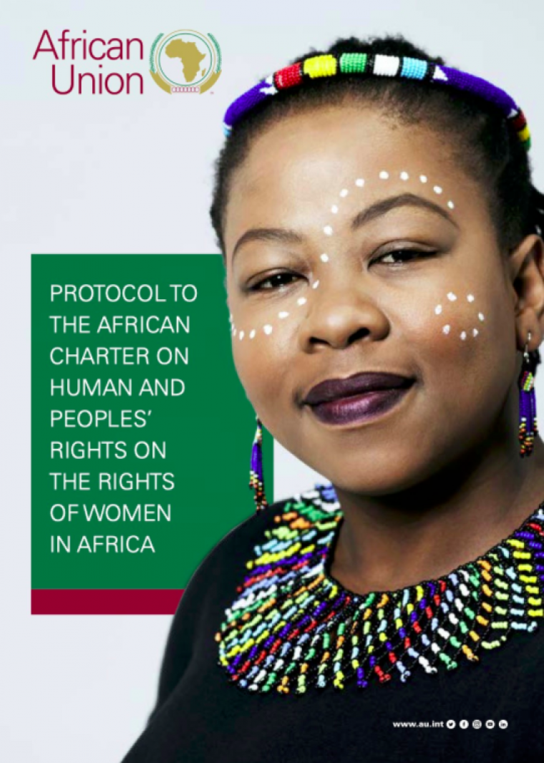
International and Regional Frameworks protecting against GBV
Convention on the Elimination of All Forms of Discrimination against Women (the CEDAW Convention)
The Charter’s Protocol on the Rights of Women in Africa
(The Maputo Protocol)
International Covenant on Civil and Political Rights 1966 (ICCPR)
Under these frameworks:
States parties must ensure that State officials do not themselves engage in gender-based violence against women
They must take appropriate measures to prevent the infliction of violence by private actors, to investigate and punish such actions, and to provide protection and support for the survivors of violence.
Convention against Torture and Other Forms of Cruel, Inhuman or Degrading Treatment or Punishment 1984 (CAT)
Notes:
The main ones:
International level: Convention on the Elimination of All Forms of Discrimination against Women (the CEDAW Convention)
Other UN human rights treaty bodies, such as the Human Rights Committee and the Committee against Torture, have also made clear that States parties’ obligations under the International Covenant on Civil and Political Rights 1966 (ICCPR) and the Convention against Torture and Other Forms of Cruel, Inhuman or Degrading Treatment or Punishment 1984 (CAT) include eliminating public and private violence against women; regional human rights bodies have reached similar conclusions under their general human rights conventions.
Regional Level: The Charter’s Protocol on the Rights of Women in Africa (The Maputo Protocol) deal explicitly with violence against women and the obligations of States.
Under these frameworks:
States parties must ensure that State officials do not themselves engage in gender-based violence against women
They must take appropriate measures to prevent the infliction of violence by private actors, to investigate and punish such actions, and to provide protection and support for the survivors of violence.

Slide 33
Human Rights and GBV National Frameworks in The Gambia

Slide 34
Laws | Adoption date | ​Adoption date
The Gambia Constitution | 1997 | Protection of fundamental human rights and freedom, including against slavery, serviture, forced labour, forced marriage, torture etc.
The Children’s Act | 2005 | Protects children from all forms of violence and abuse, economic and sexual exploitation, and trafficking. It also prohibits child prostitution, harmful publications, child marriage and harmful traditional practices.
The Trafficking in Persons Act | 2007 | Prevent, suppress, and punish the perpetrators of trafficking in persons, and to rehabilitate and reintegrate survivors of trafficking (mostly women and children).
The Women’s Act | 2010 | Innovative and comprehensive provision for the protection of women from violence that was not addressed in the 1997 Constitution or any other law in The Gambia.
Sexual Offences Act | 2013 | It criminalizes every form of sexual assault, exploitation and harassment.
Domestic Violence Act | 2013 | Addresses domestic violence and provides protection for the survivors of domestic violence, particularly women and children.
The Persons with Disability Act | 2021 | Protects the rights of Persons with disability

Slide 35
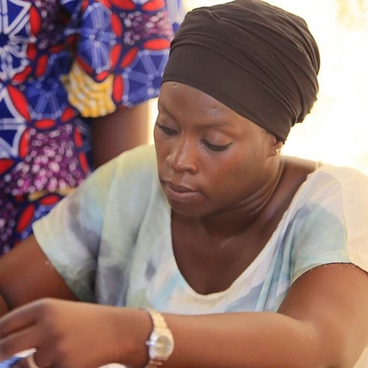
5. Reporting mechanisms and support for survivors

Slide 36
How can GBV BE PREVENTED?
2. At the organizational level
Training programs for professionals
Promote women’s empowerment
Campaigns to raise awareness
Involve men and boys
Education in non-violence and equality between women and men
Challenges gender stereotypes
At an individual level
Deconstruction of personal gender beliefs
Advocate for change in our communities
Remain in Education
Building our skills
Maintaining a positive attitude to life challenges
Notes:
We can only prevent GBV if we avert the causes of GBV
Deconstruction of social and gender norms
Advocating for change in our surroundings, community, families
Addressing negative gender norms that affect women and girls ( Deconstruction of our own gender norms, advocate for change within our surroundings,
Building our skills through education ( formal education sexual and reproductive health, menstrual health management, family planning), life skills, women empowerment program
Maintaining a positive attitude to life challenges
Training programmes for professionals such as healthcare professionals, GBV case workers, protection officers( police and justice specialist) on GBV case management standards, and how to provide services in a coordinated manner
Campaigns to raise awareness like to 16 days of activism conducted every year from the 25th of November representing the International day for the elimination of violence against Women to the 10th of December which represents to Human rights day.
Promote women’s empowerment through skills building, promotion of political participation
Involve men and boys. There is no way we are going to achieve gender equality without the involvement of men and boys as catalysts for change.
Education in non-violence and equality between women and men
Challenge Gender Stereotypes that is we deconstruct
Transforming socio-cultural norms, with an emphasis on empowering women and girls
(2) Rebuilding family and community structures and support systems
(3) Creating conditions to improve accountability systems
(4) Designing effective services and facilities
(5) Working with formal and traditional legal systems
(6) Assessment, monitoring, and documentation of GBV

Slide 37
GBV Reporting mechanisms in the Gambia
The GBV Helpline 199
The One Stop Center’s
The police
FLAG (Female Lawyers Association of The Gambia)
The GMIS (Gender Management Information System)

Slide 38
SERVICES AVAILABLE
Psycho-social services
Medical services
Police Protection
Legal Services
Temporary shelter

Slide 39
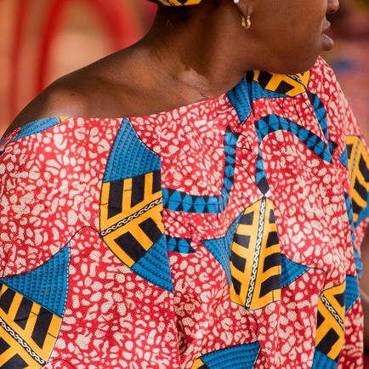
6. Case studies

Slide 40
Case Study 1: Case of rape
14 years old Gambian girl, reported a rape case through One of Our One Stop Centers early this year
According to the survivor, she was called by the alleged perpetrator who is said to be her landlord in his room.
She stated that when she got there, the alleged perpetrator told her that he was in love with her and wanted to make love to her but she refused.
She added, one day when her parents were not at home, the alleged perpetrator came to my room through the backdoor and raped her.
After raping her, he threatened to kill me and my mum if I ever tell anyone about the rape.
He later took a video of her with small children that usually come to our house to play and said that even if she tells her parents about the rape, he will deny it and say its those small children that did it to her.
A month later, she felt sick and her mum brought her to the hospital where she was told that she is pregnant.
So she decided to open up to her parents about the incident.

Slide 41
Case Study 1: Case of rape (2)
Safety:
After discussing about safety measures, the survivor’s mother confirmed that she will look for another apartment and relocate so that her daughter (the survivor) can be far from the landlord (the alleged perpetrator). In the meantime, while looking for another apartment, the survivor will be staying with her uncle in another village.
Health:
The survivor health status was checked by a doctor at the One Stop Centre and the results showed she had no critical health condition. She started antenatal condition right immediately. She will have a follow-up medical check-ups after three months on hepatitis B and HIV which is slated during the month of April 2024.
Psychosocial:
The survivor’s psychosocial state of mind was stable at the beginning of the interview. She had no self-doubt or self-blame. She has been scheduled for counselling sessions every three weeks.
Legal:
After referring the case to the police, the alleged perpetrator was arrested and detained in the cell. The case was referred to court and currently undergoing.

Slide 42
Case Study 2: Case of rape
17 year old girl gambian
According to the survivor, it all stated when she was 11.
Her uncle staying with her asGambiank her to follow him to an uncompleted building, so he can give her something
Upon arrival there, he starting touching her breasts. She wanted to shout so the uncle brought out a candle and matches and threatened to burn her alive.
So he raped her and continue doing it several times thereafter.
2 Years later when she was 13 years old, A man entered her room while she was taking her bath, asking for her aunt.
As her aunt wasn't around, he also started doing the same thing to her.
She had an uncle staying abroad who came for holidays and also started raping her just before the day she reported around 1am in her room.
She struggled to get out of the room but he did not allow me and he threatened to beat her up.

Slide 43
Case Study 2: Case of rape (2)
2 Years later when she was 13 years old, A man entered her room while she was taking her bath, asking for her aunt.
As her aunt wasn't around, he also started doing the same thing to her.
She had an uncle staying abroad who came for holidays and also started raping her just before the day she reported around 1am in her room.
She struggled to get out of the room but he did not allow her and he threatened to beat her up.

Slide 44
Case Study 2: Case of rape (3)
Services she received:
Medical services: STI testing, pregnancy testing
Psychosocial support; Several psychosocial support sessions and follow-ups were scheduled
Legal services: The survivor said she did not want to report her uncles because she was afraid it will destroy her family
She received several psychosocial support sessions and follow-up visits at the clinic until when she said she was fine and did not need the services anymore.

Slide 45
Case Study 3: Forced Mariage
18 years old Gambian girl reported a case of forced marriage
She was received at one of the country’s One Stop centres, stating she is in the process of being married by force by her parents
She left the house because the marriage was tight without her knowledge and she did not know the guy and wanted to continue her education.
She was staying with her sister for some time but her parents were threatening her sister who was sheltering her. So they were informed about the One Stop Centres. She visited one and was referred to the shelter for a short placement

Slide 46
Case 3 : Forced Marriage
We provide her with frequent sessions of psychosocial support
Our Proposed action plan was to engage DSW for mediation but she did not want us to reach out to her parents because she was afraid her parents were very angry about her.
She stayed at the shelter for 2 months and later found a friend to a family relative living abroad who was willing to welcome her into her compound.

Slide 47
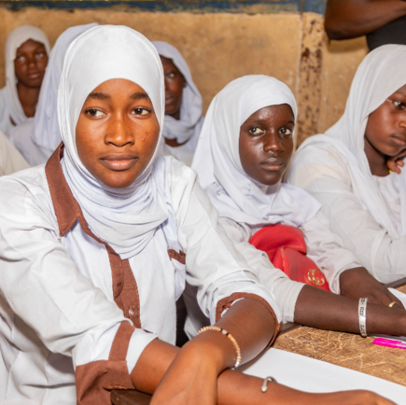
7. Conclusion and Q&A
Dr Armanda NANGMO
Alexia Lachavanne

Slide 48
For more information: - Human rights Declaration illustrated: https://www.un.org/en/udhrbook/pdf/udhr_booklet_en_web.pdf - Convention ratified by The Gambia: https://tbinternet.ohchr.org/_layouts/15/TreatyBodyExternal/Treaty.aspx?CountryID=64&Lang=EN - Maputo protocol: https://au.int/en/treaties/protocol-african-charter-human-and-peoples-rights-rights-women-africa

